Slide 1

Somatic Psychotherapy: a conversation about engaging the body in practice.
Rebeca Padilla, 2022
Notes:
Land Aknoledgement

Slide 2
Plan for today
Have a conversation about the importance of the body
How can Somatic therapy compliment your therapeutic practice?
How can it be applied?
Techniques and skills for regulation.
Somatic therapy as a resource for increasing wellness.
Q&A

Slide 3
Why am I giving this talk today?
My background in Somatic Studies: Rolfing and bodywork, Yoga, active meditation, Gestalt, Emotional Anatomy, and then finally Sensorimotor Psychotherapy (my main foundation of somatic psychology work)

Slide 4
Quick Somatic Mindful Break

Slide 5
What is Somatic Therapy?
Umbrella term for therapies that center on the mind-body connection. Somatic means “relating to the body.”
In wester psychology it extends over a hundred years back to Wilheim Reich, Freud’s direct student and the first one (in wester psychology*) to suggest that emotions and even personality traits reflected in muscular tension, posture and physical movement
Basic assumption: experiences we have as humans are held in our body and represented by it. Our body tells our story – the story teller’s experience while telling the story is what we pay attention to.
Gaining popularity last 1-2 decades, largely due to furthering understanding of Trauma.
Somatic understanding is a must in any for of effective trauma therapy.

Slide 6
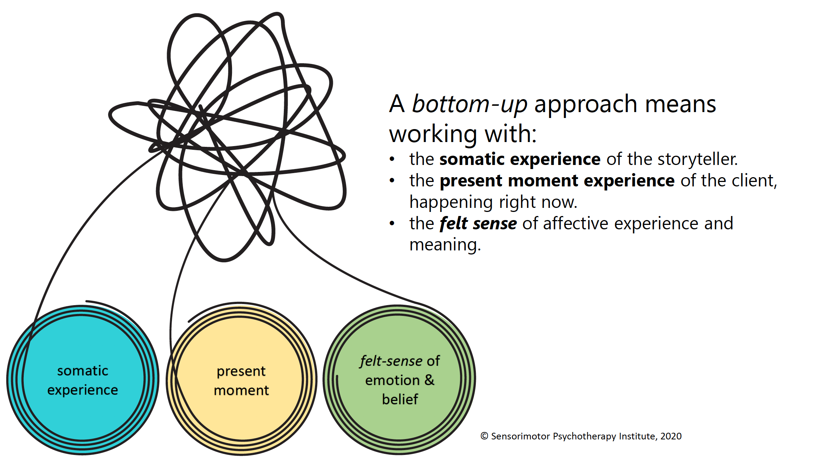

Slide 7
WHY the Body?
“Few skills are more essential than the ability to settle your body. If you can settle your body, you are more likely to be calm, alert and fully present, no matter what is going on around you. A settled body enables you to harmonize and connect with the other bodies around you, while encouraging those bodies to settle as well.” Resmaa Menakem, My Grandmother’s Hands

Slide 8
Ways to work with the Body?
1. Resourcing: nervous system regulation, expansion of clients WOT, building capacity for connection and emotional experience…..
2. Phase 2 trauma processing: specific somatic skills to help body/ANS integrate traumatic material and complete active defenses.
3. Attachment repair and Relational work: (i.e. boundaries, basic developmental movements, ability to connect and receive support... )
4. Overall increased wellness, deep connection to self and to life...
….” we need to get out of our minds and come to our senses” Fritz Perls

Slide 9
What does it look like?
Including the body in therapeutic dialogue, talking through pain rather than talking about pain.
Noting as important the clients felt sensations, posture, movements, impulses, tension, and most importantly slowing down (like really slowing down) to make room for awareness of the implicit information held in the body, to allow the client to have time and space to experience themselves.

Slide 10
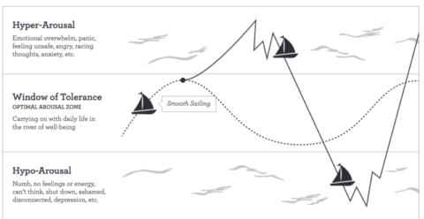
Resourcing: increasing capacity in WOT

Slide 11
Down-Regulating for Hyper-Arousal (fight/flight)
When stuck on internal sensory overload, focus on external senses, away from overwhelming internal sensations.
Grounding/Orienting: engaging senses, ex: sight (orienting in room), sound, smell, taste, touch (press against chair, ground…).
Centering/Nurturing/Calming/Self-Soothing: place hands over heart, hold arms tight and rock back and forth, hold pillow, weighted blanket, breathing techniques with longer exhales...

Slide 12
Up-Regulating for Hypo-Arousal (collapse)
When feelings are experienced as too overwhelming and sensory overload has resulted in shut down or dissociation
Focus on motor impulses: engage muscles with pressure on arms/ thighs; tap on muscles to increase circulation, apply downward pressure with hands on table; sit on the floor…
Rhythmic repetitive movement (to restore flow of life), moving body, dancing, drumming, stomping (follow client’s internal rhythm), throwing a ball back in fort with therapist…

Slide 13
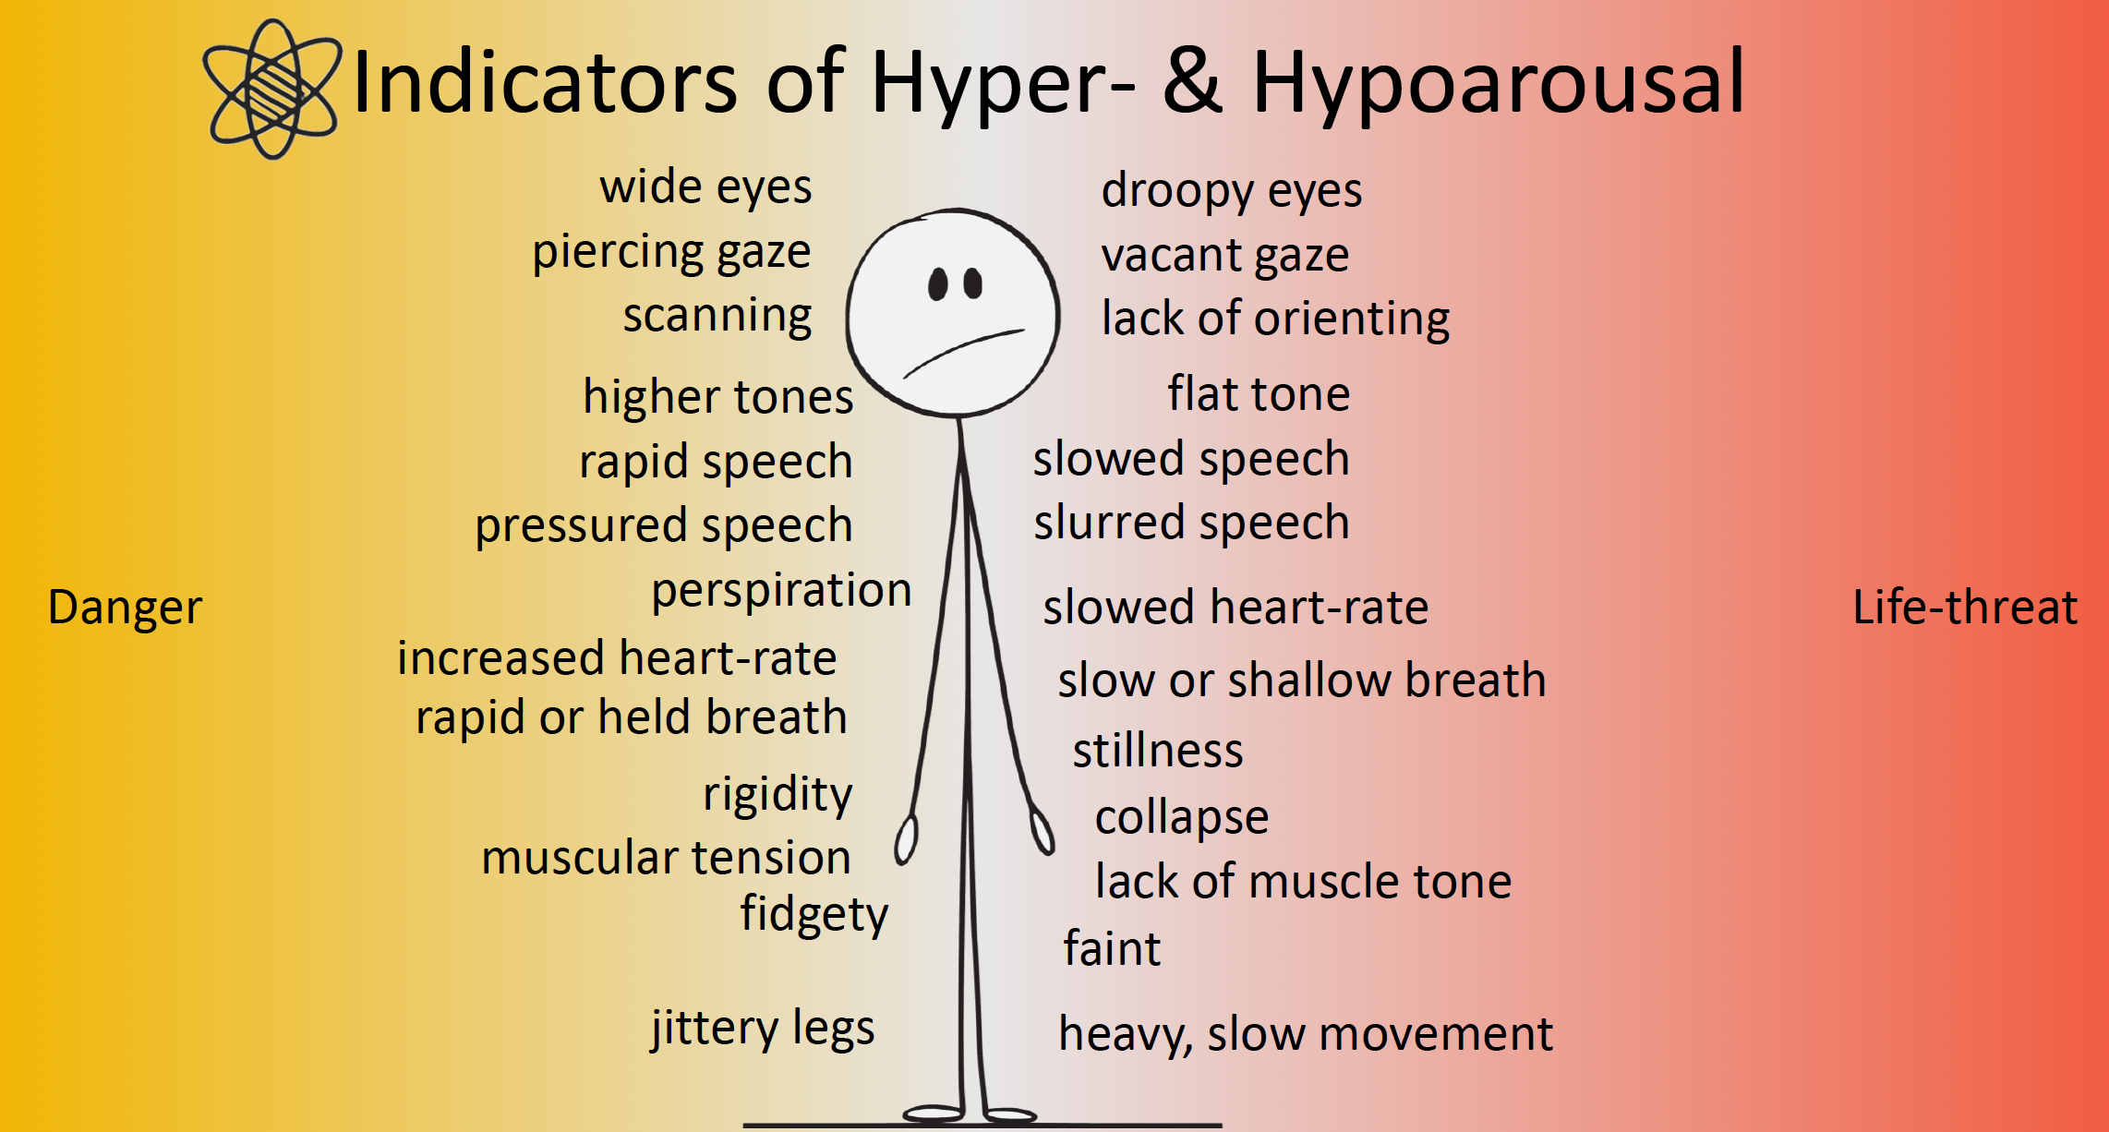
How to know when clients are getting out of the WOT?

Slide 14
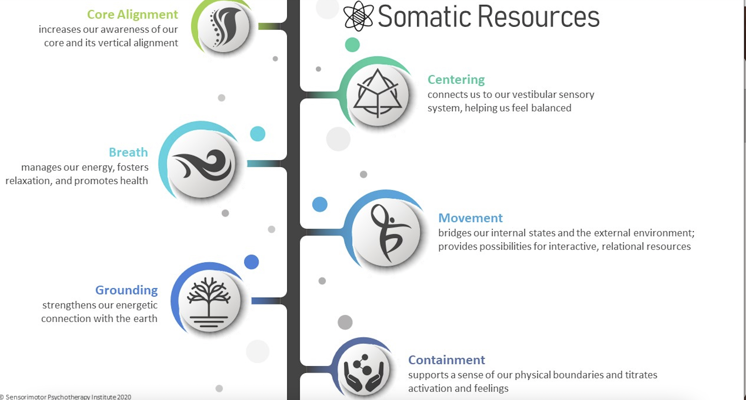

Slide 15
Beyond Regulating and Resourcing?

Slide 16
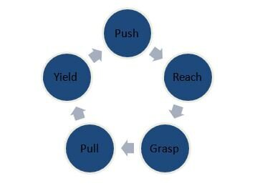
Attachment and Relational Somatic Work
One example is working with the basic human Developmental Movements
They have strong psychological significance and impact how we relate to the world
Which one needs further development?
Which one is overdeveloped?

Slide 17
How to start?
Be Genuinely Curious of your clients’ somatic experience
Questions to Ask:
  Where do you feel it in your body?
  Can you describe that sensation?
  What happens to your (i.e.., jaw, chest, breath) as you talk about xyz
  Is there a movement that goes with that?
  What happens if you intensify that sensation? Make it bigger?
  Are there words that go with that movement?
  Is there a color/image/ associated..?
Reflections to make:
  I notice you take a deep breath when you mention your …
  Your hands move in this way (mirror back the movement) when you share about …
Allow Client to SLOW DOWN and STAY WITH THAT
  I invite you to stay with that for a moment…
  Be VERY comfortable with silence, surprise, not knowing...

Slide 18
Easiest way to start: FOCUS ON WELLNESS
Turn everyday good experiences into good neural pathways)?
  By engaging our senses as much as possible!
Increase wellness with somatic skills: taking in the good
Don’t quickly skip ahead when a client shares something good, we want to chew on all the juices of that goodness!
”Good” facts usually do not get converted into neural structures info must be held ”long enough” in our awareness to be stored to long-term storage

Slide 19
Savouring to increase Wellness and WOT
Definition: Savouring is the practice of bringing to life a positive moment/experience
Goal: increase, lighten up as much neuro-networks as possible, prolong and appreciate (savour/slow chew) the positive experience in order to create a positive affect (emotion)
Consequence: it energizes the ventral vagal system, and increases capacity in the WOT, and more pleasurable neuro pathways
Creates Resources!

Slide 20
Savouring
Steps:
1. Notice an experience happening in the moment (right now) OR ask client about positive past experience, place, person…
2. Stop to take time to notice positive experience with client.
3. Ask questions to clients about state (sensations) connect with as many senses as possible, and connect with the emotions, images, thoughts also… but stay in the here and now – Present moment awareness is key!
4. Have client stay with it for a long time…slow down (even slower)

Slide 21
“In the midst of trauma-saturated lives, there are micro-moments of ventral vagal safety and connection worthy of savouring”. (p.166)
”Once clients understand the science of savouring and become accustomed to stopping and savouring, they begin to look for moments to savour on their own” (p.166).
Deb Dana’s book “ Polyvagal theory in therapy”

Slide 22
Therapists’ Roles
Orient to the positive in sessions
Be on the lookout for moments to savour
Happen regularly even in the most complicated cases
Often go unnoticed by the client (and therapist)
Stop to take time to notice them (slow down and savour)
Helps clients notice and start noticing them outside of therapy too
Yay, you are helping your client widen their window, orient and experience more goodness!

Slide 23
Examples of Body-Based Psychotherapies
Somatic Experiencing, Peter Levine
Sensorimotor Psychotherapy, Pat Ogden
Hakomi, Ron Kurtz
Integrative Body Psychotherapy
Relational Somatic Therapy, Mariah Moser
Janina Fisher’s work (combo of SP and IFS)
Somatic attachment Training, Lisa Mortimer

